Slide 1
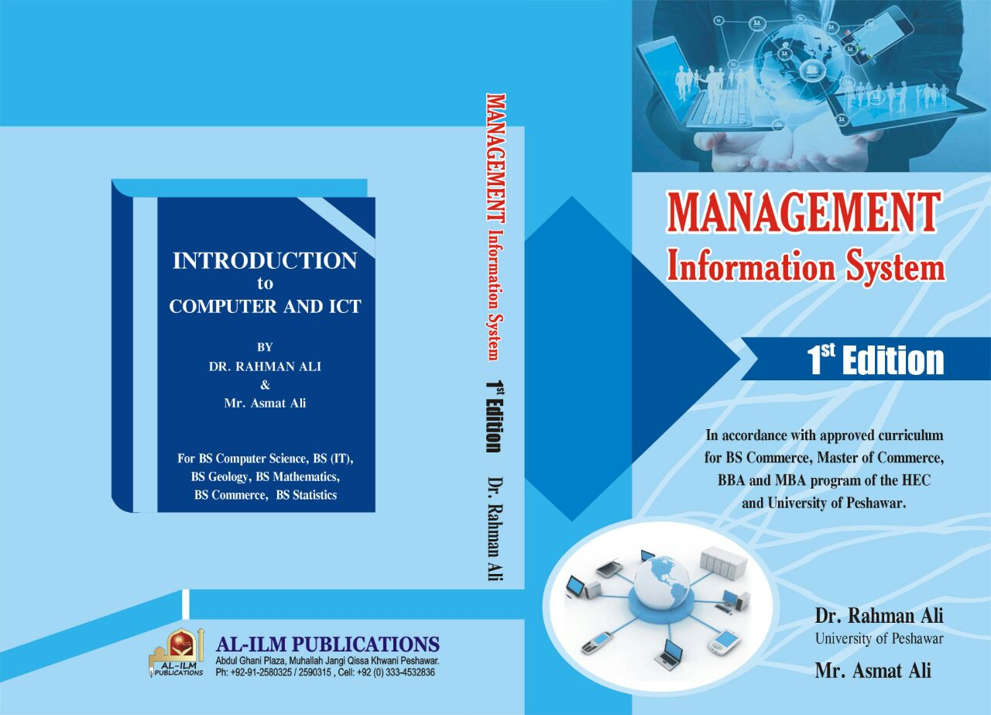

Slide 2
Chapter 1: Information System in Business
Introduction to System
System
Cybernetic system
Business as a system
Fundamentals of Information System
Information System (IS)
Components of IS
Activities of IS
Importance of IS
Brief Overview of Information System
Operation Support System
Management Support System
Others
Dr. Rahman Ali, University of Peshawar. rahmanac1@gmail.com
Mr. Asmat Ali, GHSS Mingora Swat.
aasmat76@gmail.com

Slide 3
Introduction to System
What is System
Originated from the Greek term systēma, which means to “place together.”
System is a set of interrelated components with a clearly defined boundary working together to achieve a common set of objectives.
For example, human digestive and respiratory systems etc.
Cybernetic System
A self-monitoring, self-regulating system that adds feedback and control to itself to improve its performance.
Feedback is data about the performance of a system and
Control involves monitoring and evaluating feedback to determine whether a system is moving towards the achievement of its goal.

Slide 4
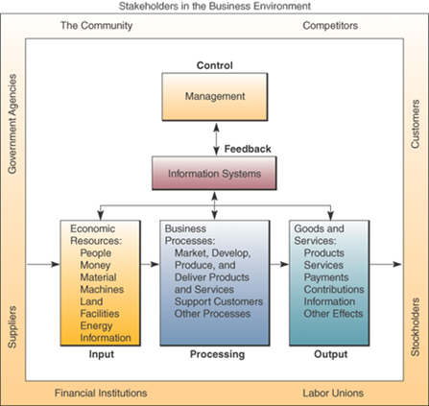
Business as a System
Business as a System
Each business can be viewed as a system
It is a collection of interrelated components, such as supplier, customers, government agencies, financial institutions, labor unions, and competitors to achieve a common goal by applying system basic functions of input, processing and generating output.
Has the functionality of learning from its feedback and control mechanism, therefore we can say that business is not only a classical system but a cybernetic system.
Figure ‎1.1: Business as a system

Slide 5
Information System
Information System
An organized combination of
hardware, software, personnel, infrastructure, data resources, policies and procedures to facilitate planning, control, coordination, and decision making is called information system.
An information system
stores, retrieves, transforms, and disseminates information in an organization.

Slide 6
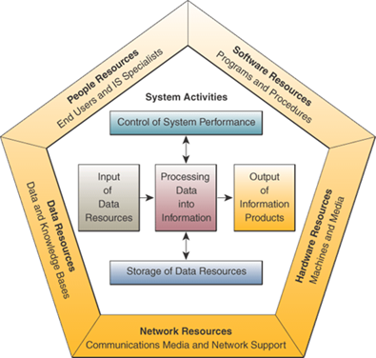
Components of IS
Hardware Resources
Software Resources
People Resources
Infrastructure and network Resources
Data Resources
Other components or resources may include
Policies and procedures:
the business rules and regulations applied or implemented in the information systems are called policies and procedures.
Information Resources:
management reports and business documents using text and graphics displays, audio responses, and paper forms are the information resources.

Slide 7
Information System Activities or functions
Input:
involves capturing and assembling elements that enter the system to be processed
Processing:
involves transformation process that convert input into output. It includes messages, reports, forms, graphic images etc.
Output:
involves transferring elements that have been produced by the transformation process to their ultimate destination
Storage of data resources:
it includes data elements and databases.
Control of system performance:
it includes monitoring and evaluating feedback.

Slide 8
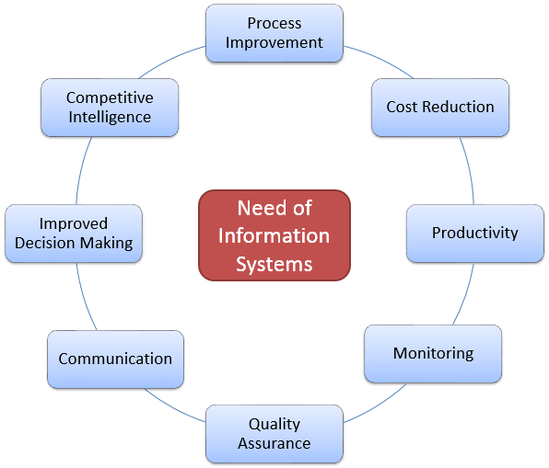
Importance of Information System in Business

Slide 9
Brief Overview/Types of Information Systems
For Detail: See Chapter 7

Slide 10
Types of Information Systems
Operations Support Systems (OSS)
Support businesses in their daily operations
Examples of OSS include:
Transaction processing systems –
used for storing daily transaction data such as sale transaction etc.
Process Control Systems –
used for monitoring physical processes
Enterprise Collaboration Systems –
used for enabling communication among team members of the same organization to work together.

Slide 11
Types of Information Systems
Management Support Systems (MSS)
Systems that are supposed to be used by, or at least to support, managers to properly manage their business activities and take decisions.
Examples of MSS include
Management Information Systems –
produce scheduled reports based on data extracted and summarized from the organization’s databases
Decision Support Systems –
used by middle and higher management to compile information from a wide range of sources to support problem solving and decision making.
Executive Support Systems –
used for reporting enterprise-wide data to top executives for strategic planning type decision making.

Slide 12
Other Information Systems
Expert System –
Specialized computer program that mimic human expertise
Used in different business areas for diverse types of problem solving and decision making.
Business Information Systems –
Used for human resource system, inventory and sale systems etc.
Group Decision Support Systems –
An interactive computer-based system that supports the process of finding solutions by a virtual group of decision makers.
Support brainstorming before decision making.
Marketing Information Systems. –
Support activities that helps businesses in marketing and advertisement etc.
Strategic Information Systems –
Uses IT to support or shape the competitive position and strategies of an enterprise.
Knowledge-based System –
Refers to an IT-based system used for supporting capturing, creation, storage and dissemination of useful business information within the organization.

Slide 13
Ali, R. & Ali, A. (2018). Chapter 1: Information System in Business. Management Information System – 1st Edition (pp. 1-13). Mahla Jangi, Qissa Khawani, Peshawar, Pakistan: Al-ilum Publications.

